Slide 1

Activation Functions
Explained for Beginners
Why Non Linearity? Vanishing Gradient?

Slide 2
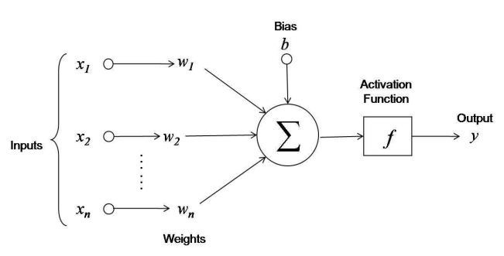
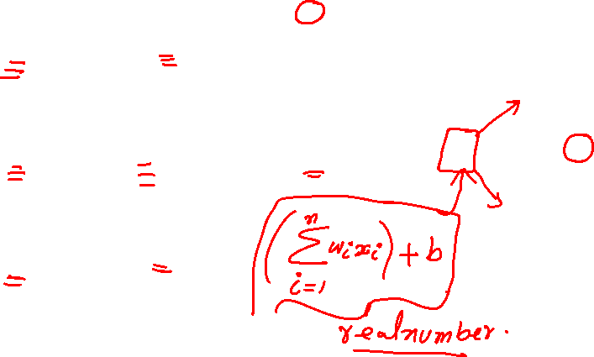
AF

Slide 3
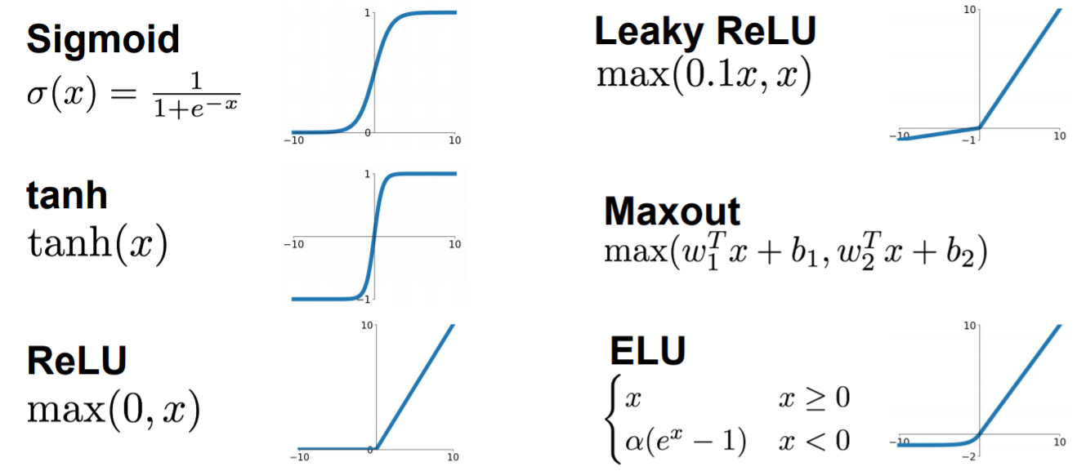

AF

Slide 4
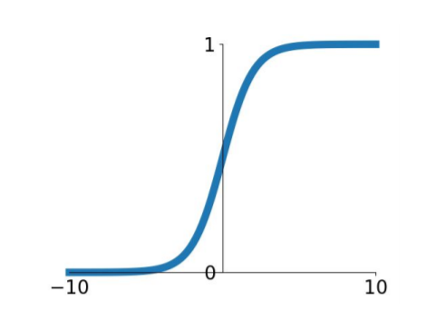

Sigmoid

Slide 5
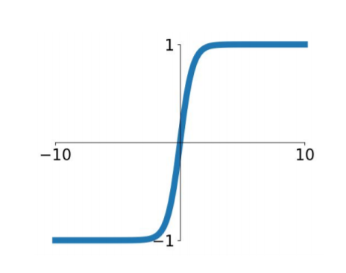

tanh

Slide 6
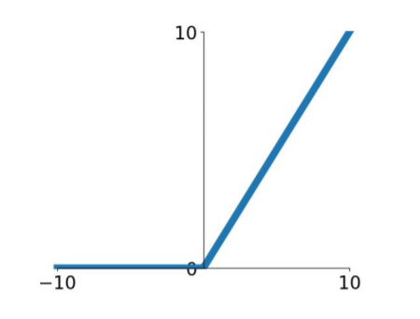

ReLU

Slide 7
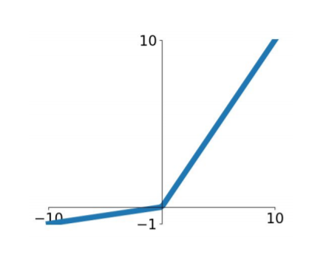

Leaky ReLU

Slide 8
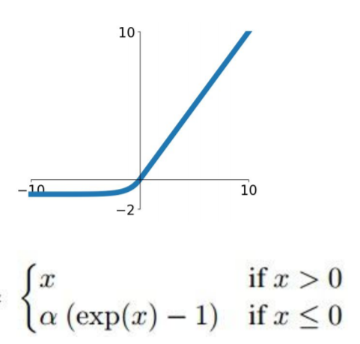

ELU

Slide 9

Maxout

Slide 10
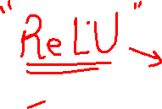
Website : www.aisciences.io

